Slide 1
HISD 101 Fundamental Resources for Parents
Family and Community Engagement (FACE) Department
Embracing Partnerships. Advancing Learning
Notes:
Handouts:
Parent Guide Pg. 1, 2, 3
Elementary Resources
Secondary Resources
Facilitator Notes:
Welcome participants to the session.
Introduce yourself to the group.

Slide 2
Norms
Stay engaged
Expect to experience discomfort
Speak your truth
Expect and accept a lack of closure
Adapted from Glenn E. Singleton & Curtis Linton, Courageous Conversations about Race: A Field Guide for Achieving Equity in Schools. 2006. pp.58-65. Thousand Oaks, CA: Corwin.
Notes:
Staying engaged: We know you made a choice to be here, and you may have calls, or certain things that are pressing your time. If you need to take a call, please step outside and comeback when you are ready. We respectfully ask that while here you are participating and following the presentation.
2. Expect to experience discomfort: This norm acknowledges that discomfort is inevitable, especially, in dialogue about issues that can generate diverse opinions. The information shared here is meant to create awareness and equip you with strategies that can help in the academic success of your children.
3. Speak your truth: Your experience is your truth, you are welcome to share it, we just ask that you do so respectfully.
4. Expect and accept a lack of closure: We are not going to solve everything in our time together, but hopefully we will leave today with a different level of awareness that can allow us to start implementing small changes that can have great impact in our children’s lives.

Slide 3
Objectives
Parents will be able to:
Learn more about the importance of Parental Involvement
Get an overview of relevant HISD resources and programs to support learning at home
Understand how to navigate the HISD website to resources
Notes:
Facilitator Notes:
Read objectives

Slide 4
What Research Says
Notes:
Facilitator Notes:
Why is parental involvement so important?
Research from over 50 years shows that parental involvement is one of the strongest predictors of children’s success in school. When schools, families, and community groups work together to support learning, children tend to do better in school, stay in school longer, and like school more. Overall, children whose parents are involved in their education tend to:
Earn higher grades &
test scores
Enroll in higher-level program
Succeeds academically
Attend school regularly
Improve social and behavioral skills
Graduate and pursues post-secondary education

Slide 5
Parent Activity
List 3 HISD Resources to Guide and Support Learning at Home:
Notes:
Facilitator Notes:
Activity-
Have parents share their answers out loud with group.

Slide 6
HISD Resources
Students
&
Parents
Frequently Requested Forms
Grade by Grade
School Supplies
Career Readiness
Meal
Transportation Buses
Board
And many more resources…
Notes:
Facilitators Notes:
These are some of the HISD resources that can be found on the HISD website that supports students and parents.
Frequently Requested Forms: Forms that parents/guardians must fill out at the beginning of the 2019-2020 school year for each individual child enrolled at HISD. All forms are to be returned to a child’s school. Campuses typically will provide the forms in an information packet sent home with the child. These forms can be downloaded and printed using the links provided. Also provided in three different languages.
Grade: Grade by grade, parents will be able to view grades online by login to the HISD Parent Connect.
School Supplies: For students and families facing financial challenges, assistance in purchasing school supplies or uniforms may be available through Title I funds, which were decentralized so that the money goes directly to schools. The Title I Program provides federal funds to help economically disadvantaged children. Contact your child’s school directly to find out if it offers Title I assistance.
Library Resources : HISD website has information about Houston Library. Students have access to check out and book with their student’s ID. HISD library link has also access to online Primary and Secondary resources online on reading, writing, math and science to enhance the quality of learning.
Career Readiness: The HISD College Readiness Department, which is under the division of College and Career Readiness, is committed to providing higher education access to all HISD students and works closely with campuses and district departments to create and maintain a college-bound culture throughout the district.
Meal : Lunch menu calendar
Transportation: Parent information busses, forms and documents, and safety rules.
Board: HISD board meetings dates and members.

Slide 7
HISD Resources
Parent University & Parental Involvement
English Video
Spanish Video
Notes:
Facilitator Notes:
Lets watch this video that talks about an additional resource that HISD offers to parents called Parent University. Some of you have heard about it but let us learn some more information about what it offers.
(Play Video)

Slide 8
How to Navigate HISD Website
Notes:
Facilitator Notes:
Lets now learn how to navigate the HISD website

Slide 9
Navigating HISD Website
Navigate to www.houstonisd.org
Notes:
Facilitator Notes:
Accessing the HISD website; HOUSTONISD.ORG

Slide 10
Navigating HISD Website
Select “Students & Parents” to access HISD resources
Notes:
Facilitator Notes:
2. Click on the Student and Parent Tab

Slide 11
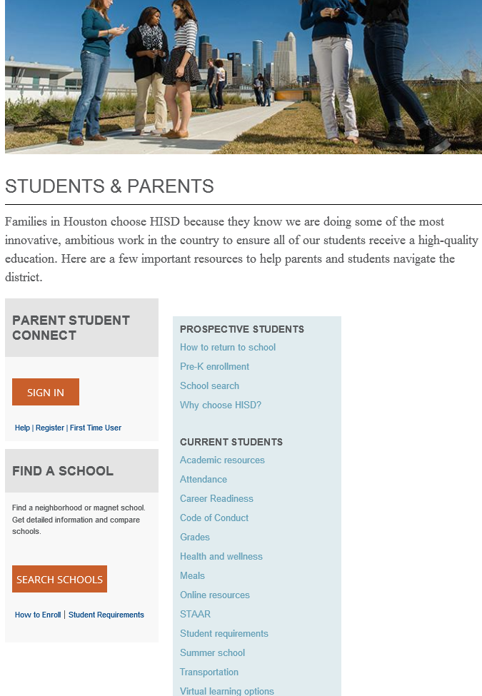
Navigating HISD Website
Students & Parents Page:
Notes:
Facilitator Notes:
3. In this outline you can see all the resources that are available under this tab (discuss some of them).

Slide 12
Navigating HISD Website
Select “Directory” to access HISD Department Directory
Notes:
Facilitator Notes:
Parents can also access the Directory that will give you an alphabetical list of all the different departments in the District.

Slide 13
Navigating HISD Website
Locate resources or related departments
Notes:
Facilitator Notes:
When you click on a department’s name this is how their department page might look like.
This is the Family and Community Engagement department's page. We have many resources on our page that are available to parents such as the VIPS program, Community resources guide and the steps on how to start a parent organization.
When you get a chance, explore the houstonisd.org website and see what other resources and information you can find.
Also accessing your schools website can be very beneficial in finding calendar information, notices, forms and access to your child’s teacher.

Slide 14
Exit Ticket –
“ Behind the child that makes the most progress, is an actively involved parent/legal guardian.”
Which HISD resources and programs will support learning at home for you and family?
Notes:
Facilitator Notes:
Read quote
Before leaving today ask yourself the following question (read question out loud)
I hope this short guide can help you open the doors on finding resources right for your family.
Questions?
(Allow time for questions)

Slide 15
Resource Page
HISD Website:
www.houstonisd.org
www.parentuniversity.org

Slide 16
FACE Contact information
Virgil Elkins
Phone: 713-556-7290
Email: FACE@HoustonISD.org
Twitter: @hisdface
Web: houstonisd.org/face
Notes:
Facilitator Notes:
This is our contact information.
Do not forget to follow us on twitter.

Slide 17
Thank you

